Slide 1
Service Point Placement By Customer Geolocation Clustering
Location, Location, Location
When Distance, Distance, Distance Matters
Constantia Malekkou
Dr. Demetris Trihinas
Notes:
The famous quote location location location to stress the importance of location and for this specific work, I have added to this the when distance….
Location important for the success of a retailer company that relies on a distributed branch network to promote its goods and services.
The distance to the nearest service point is an important factor to consider, as it is a measure of convenience for its customers.
The initial set-up costs required for the establishment of a new service point should be carefully weighed against the expected benefits, as future relocations or new establishments translate to additional, unnecessary costs.

Slide 2
Service Point Placement By Customer Geolocation Clustering
Objective
Identify optimal placement for service points given that customers’ geolocation is known
Applicable to
Retailer companies that depend on a distributed physical branch network
Why
Improve customer experience, minimize service times and distance to service points while potentially increase their revenue

Slide 3
Literature Review
Maximal Covering Location Problem
To identify service points that would maximize population coverage over a desired service distance by locating a fixed number of facilities.
Maximize population coverage
Various location solutions may exist for a given number of facilities. The optimal solution is the one that maximizes population coverage within the desired service distance for a fixed number of facilities
Desired Service Distance
The distance within which customers should be serviced
Fixed Number of Facilities
The cost related to opening and operating a new service point, including land acquisition, construction and/or renovation, and ongoing location operation and maintenance
Church R, ReVelle C. The maximal covering location problem. Papers in regional science 1974; 32: 101-118

Slide 4
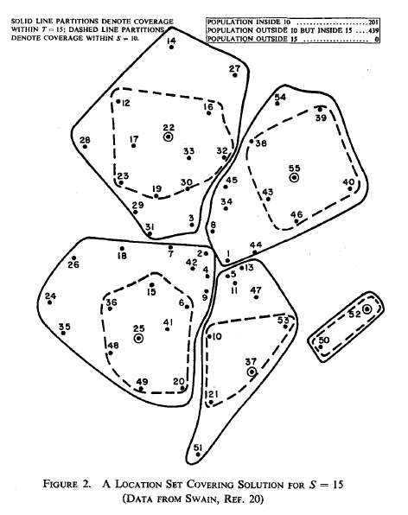
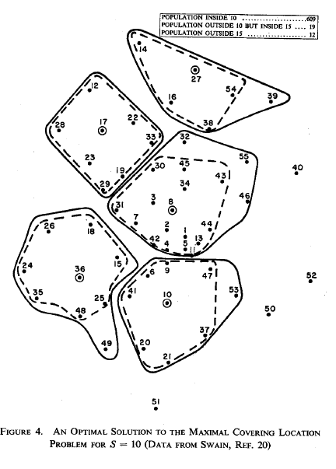
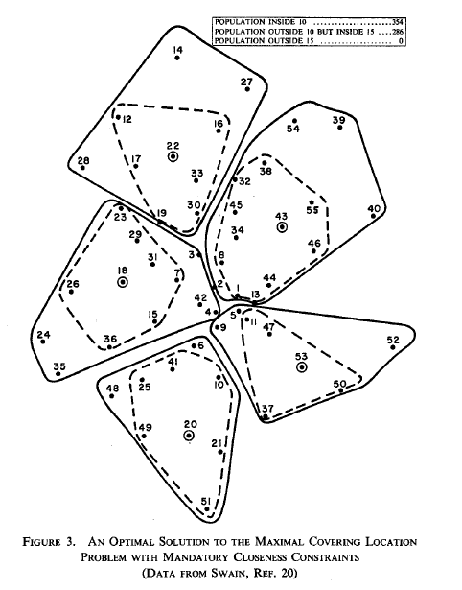
Maximal Covering Location Problem
Number of facilities: 5
Desired Service Distance S: 10
Maximum Service Distance T: 15
Population Covered within S: 201 (31%)
Population Covered outside S and within T: 439 (69%)
Population Not Covered (outside T): 0
Number of facilities: 5
Desired Service Distance S: 10
Maximum Service Distance T: 15
Population Covered within S: 354 (55%)
Population Covered outside S and within T: 286 (45%)
Population Not Covered (outside T): 0
Number of facilities: 5
Desired Service Distance S: 10
Maximum Service Distance T: 15
Population Covered within S: 609 (95%)
Population Covered outside S and within T: 19 (3%)
Population Not Covered (outside T): 12 (2%)
Church R, ReVelle C. The maximal covering location problem. Papers in regional science 1974; 32: 101-118

Slide 5
Distance as Quality of Service
Assumptions
All service points provide the same service to customers
Customers are serviced by their nearest service point
Quality of Service is a function of the distance to the nearest service point
Eiselt HA, Marianov V. Gradual location set covering with service quality. Socio-economic planning sciences.
2009 Jun;43(2):121-30

Slide 6
Service Point Placement By Customer Geolocation Clustering
Initial Population
List of Cyprus registered organizations and their registered office addresses through the CY Open Data Portal
Address Text-To-Geolocation
Google Maps Geocoding API to geocode the text addresses
Method
k-Means clustering on geolocations
Result
Optimal service point number and locations for the sample population
Evaluation
Comparison of the model’s results against the existing service point placement of two competitor retailer companies

Slide 7
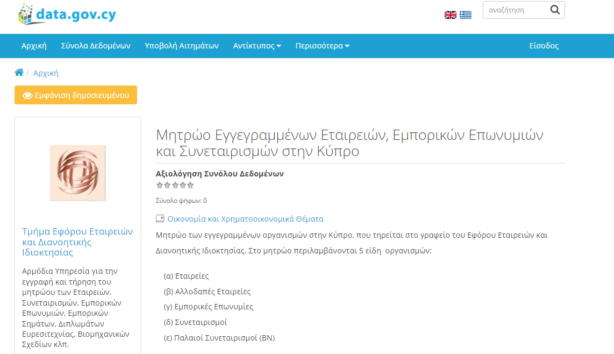
Initial Population

Slide 8

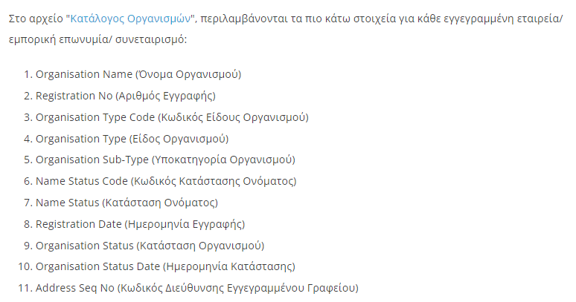
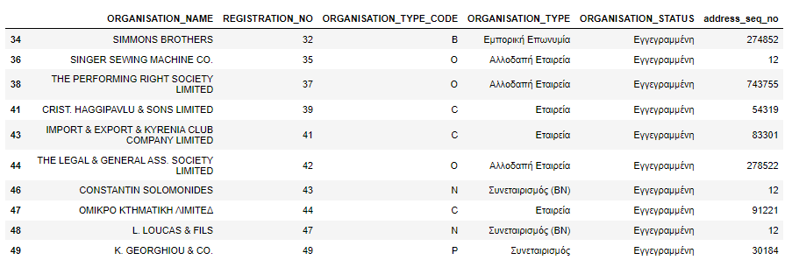
Initial Population
List of organizations
Organizations Dataset
Total Organizations Dataset | 509.647
Filtered ‘Active’ Organizations | 238.725

Slide 9
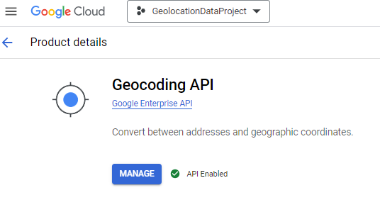

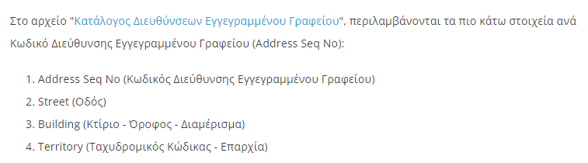
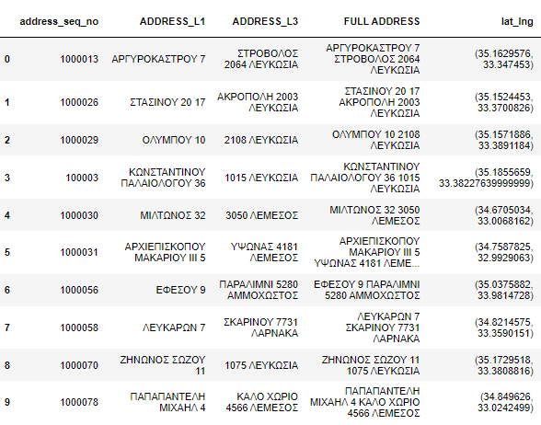
Initial Population
List of registered office addresses
Address Dataset
Total Initial Addresses | 178.916
Unique Geocoded Addresses | 79.894

Slide 10
Initial Population
Organizations Dataset
Address Dataset

Slide 11
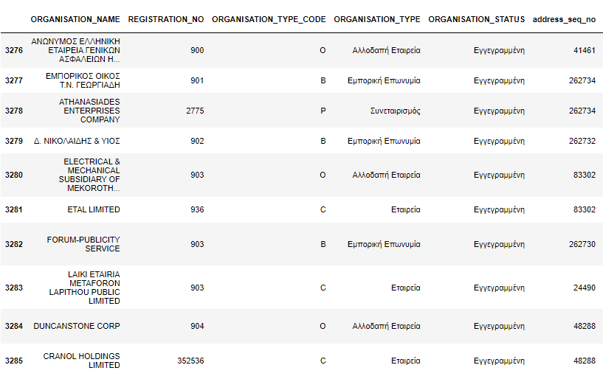
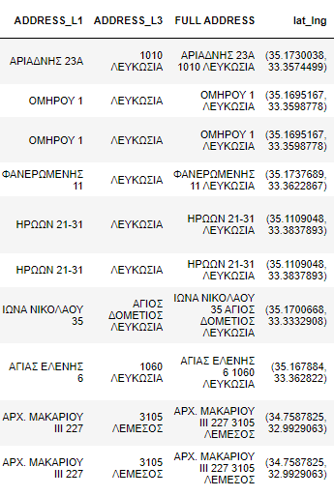
Initial Population
Population with Geocoded Addresses within Cyprus Geocoordinates | 217.788

Slide 12
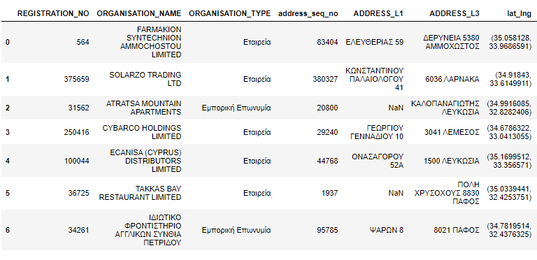
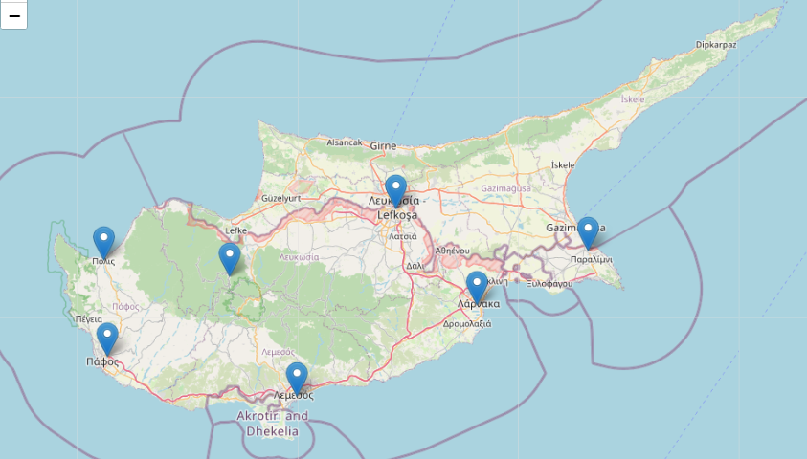
Sample Population Map Visualization

Slide 13
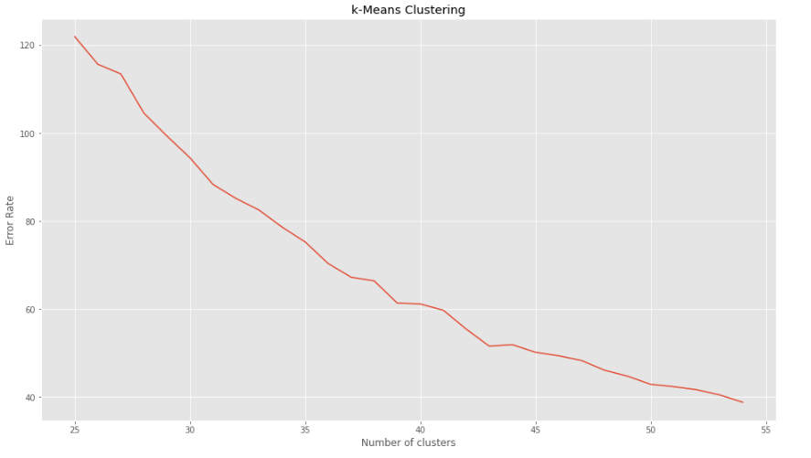
k-Means Clustering
Number of clusters
The number of distinct clusters of geolocations
Error rate
Sum of squared distances to the cluster centroids
“Elbow” point
The point when the marginal gains in error rate reduction start diminishing, indicating that the cost-effectiveness of adding more clusters is also reduced
37

Slide 14
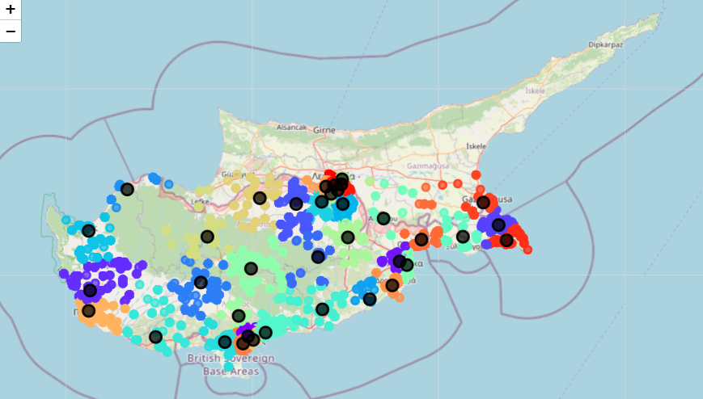






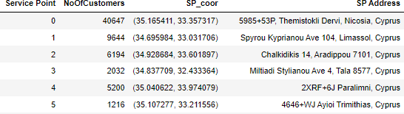
k-Means Clustering Results Overview
Legend
Cluster Centroids
Population Clusters

Slide 15
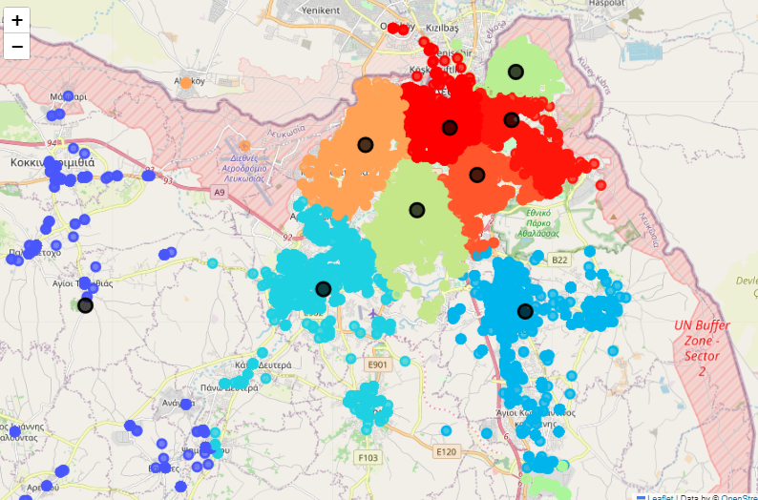
k-Means Clustering Results Detail

Slide 16
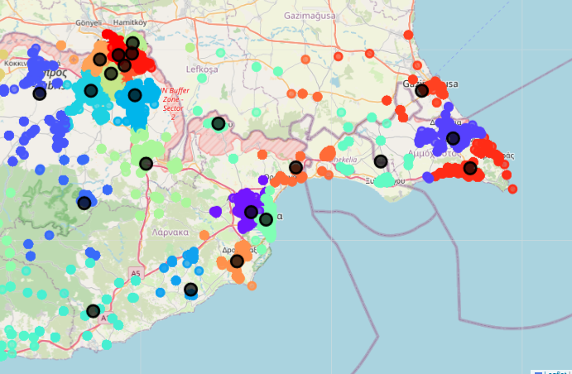
k-Means Clustering Results Detail

Slide 17
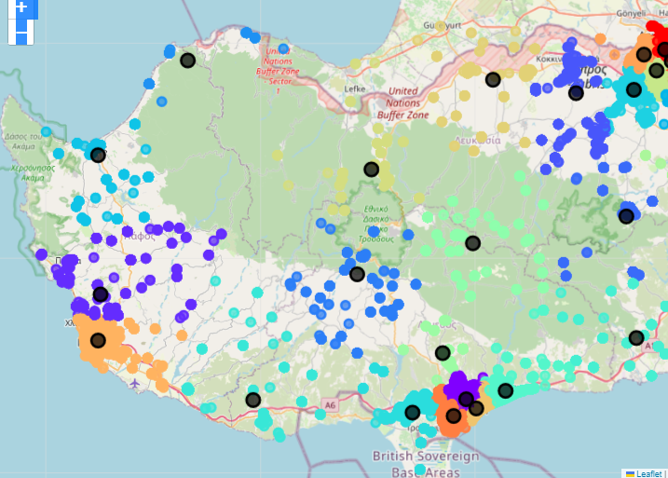
k-Means Clustering Results Detail

Slide 18
Model Evaluation
Applicable to chains of gas stations, pharmacies, convenience stores, kiosks
Collected the existing service point locations for two retailer market competitors - Comp A | Comp B
Calculated the distance to all service points of Comp A, Comp B for every demand point in the initial population
Collected the nearest service point for each demand point for Comp A, Comp B
Nearest service point for each demand point for the Model is its cluster centroid

Slide 19
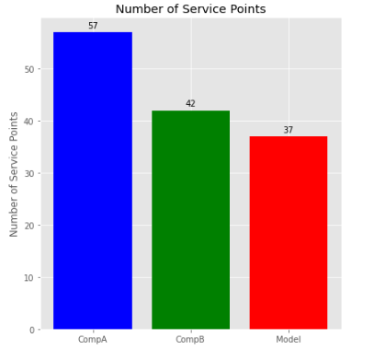
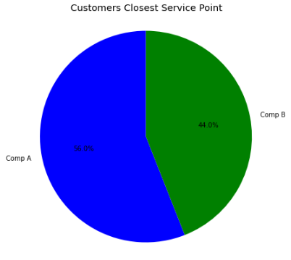
Number of Service Points
 | Number of Service Points | Number of Customers | Percentage
Comp A | 57 | 121.909 | 56%
Comp B | 42 | 95.879 | 44%

Slide 20
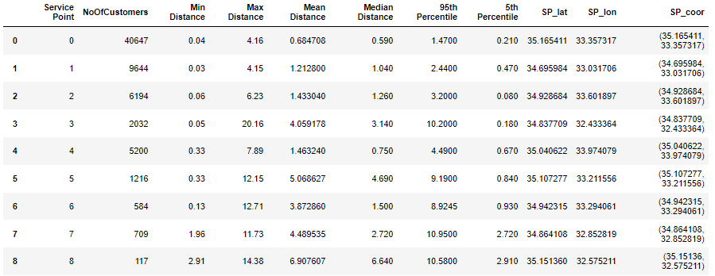
Comparison Metrics
Calculated the same metrics for Comp A, Comp B and the Model
Number of customers per service point
Min, Max, Mean, Median distance to service point
5th and 95th Percentile distance to service point

Slide 21
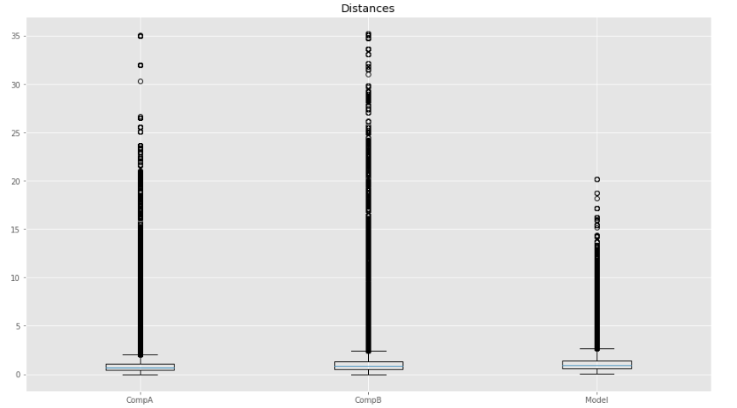
Distance to Nearest Service Point
Distance

Slide 22
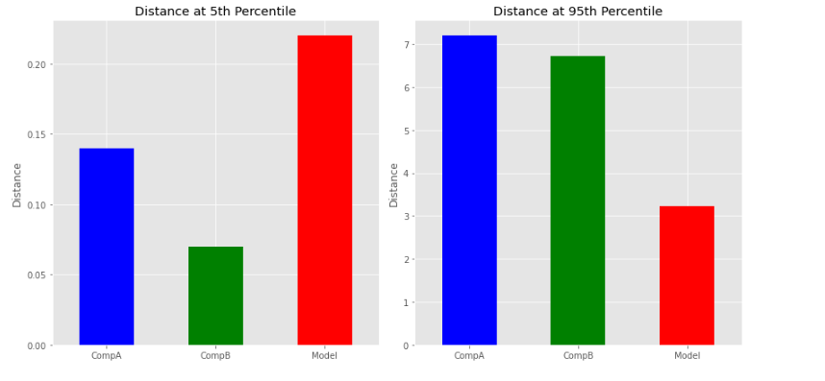
Distance to Nearest Service Point
(5th and 95th Percentile)

Slide 23
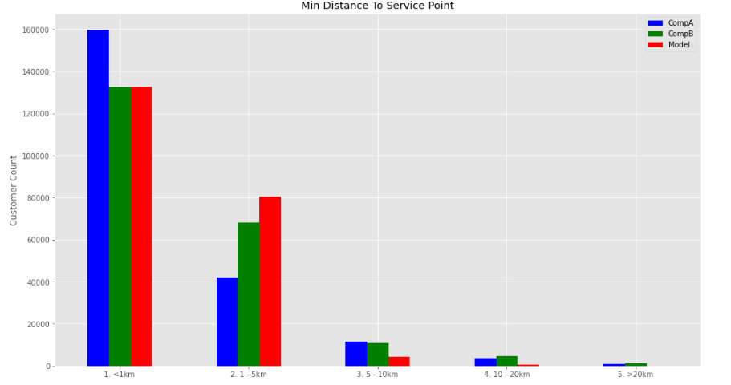
Distance Group to Nearest Service Point
Number and percentage of customers per distance group
Distance Group | CompA |  | CompB |  | Model
 | N Customers | % | N Customers | % | N Customers | %
<1 km | 159.719 | 73,33% | 132.461 | 60,82% | 132.432 | 60,81%
1-5 km | 41.945 | 19,26% | 68.108 | 31,27% | 80.455 | 36,94%
5-10 km | 11.490 | 5,28% | 10.992 | 5,05% | 4.267 | 1,96%
10-20 km | 3.589 | 1,65% | 4.824 | 2,21% | 631 | 0,29%
>20 km | 1.045 | 0,48% | 1.403 | 0,64% | 3 | 0,00%
Total Customers | 217.788 | 100,00% | 217.788 | 100,00% | 217.788 | 100,00%
Notes:
Number of customers to be serviced
Distance ranges
Greater distance ranges the model’s number of customers is significantly reduced

Slide 24
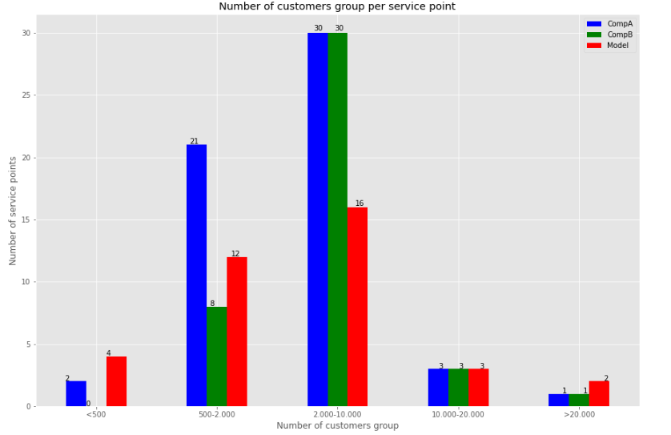
Service Points By Number of Customers Group
Customers Serviced Group | Comp A | Comp B | Model
Customers Serviced Group | N Service Points | N Service Points | N Service Points
< 500 | 2 | - | 4
500 - 2.000 | 21 | 8 | 12
2.000 - 10.000 | 30 | 30 | 16
10.000 - 20.000 | 3 | 3 | 3
> 20.000 | 1 | 1 | 2
 | 57 | 42 | 37

Slide 25
Service Points By Number of Customers Group

Slide 26
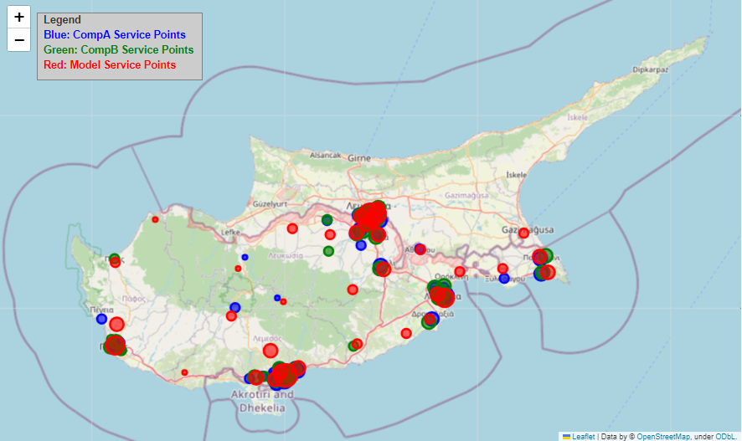


Service Point Spatial Distribution with Size
Number of Customers Group
<500
500 – 2.000
2.000 – 10.000
10.000 – 20.000
>20.000

Slide 27
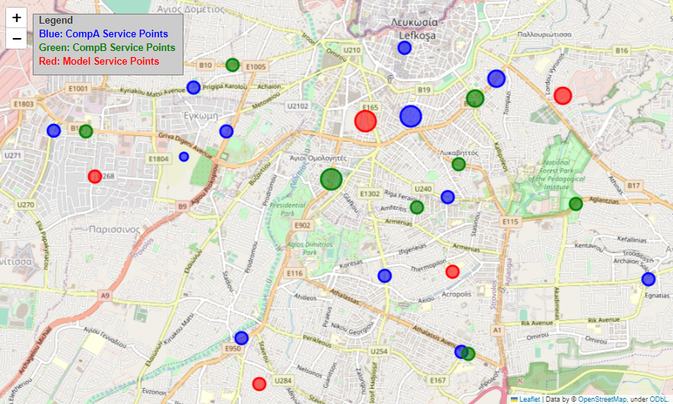
Service Point Spatial Distribution with Size
Nicosia, Cyprus
Number of Customers Group
<500
500 – 2.000
2.000 – 10.000
10.000 – 20.000
>20.000

Slide 28
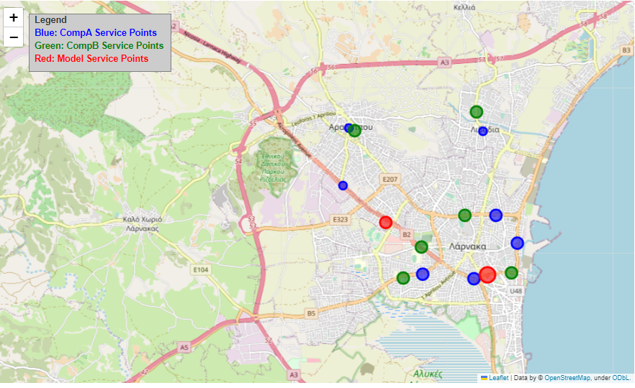
Service Point Spatial Distribution with Size
Larnaca, Cyprus
Number of Customers Group
<500
500 – 2.000
2.000 – 10.000
10.000 – 20.000
>20.000

Slide 29
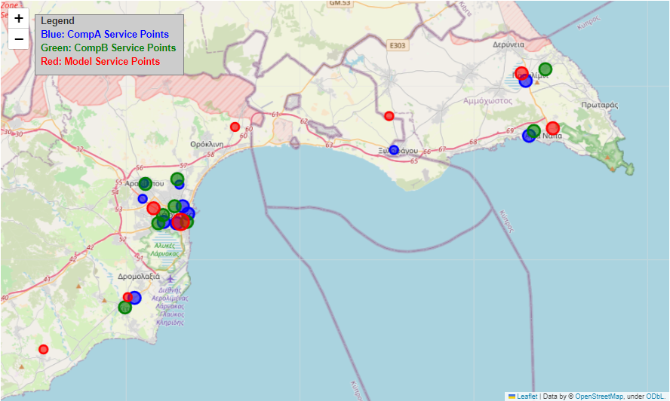
Service Point Spatial Distribution with Size
Ammochostos, Cyprus
Number of Customers Group
<500
500 – 2.000
2.000 – 10.000
10.000 – 20.000
>20.000

Slide 30
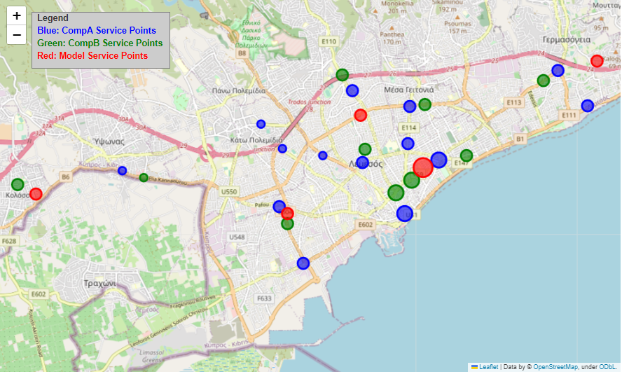
Service Point Spatial Distribution with Size
Limassol, Cyprus
Number of Customers Group
<500
500 – 2.000
2.000 – 10.000
10.000 – 20.000
>20.000

Slide 31
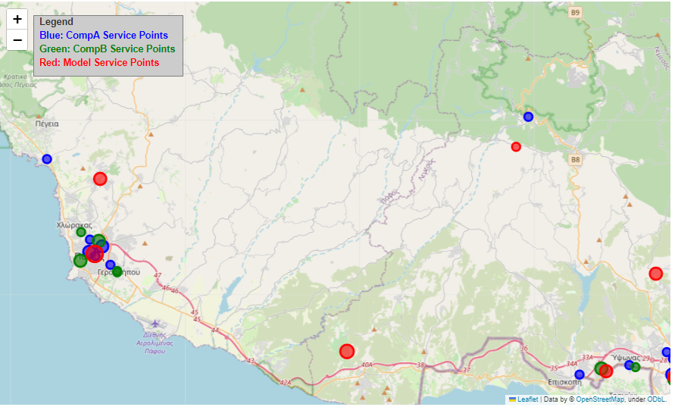
Service Point Spatial Distribution with Size
Paphos, Cyprus
Number of Customers Group
<500
500 – 2.000
2.000 – 10.000
10.000 – 20.000
>20.000

Slide 32
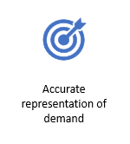



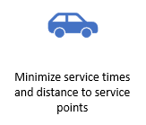
Service Point Placement By Customer Geolocation Clustering
Distance

Slide 33
Limitations / Future Work
Service Points By Number of Customers Group
Limitations
Proportion of population (34%) to be served by 2 single service points has limitations:
Size of service point
Land availability and cost
Construction / renovation cost
Parking spaces to accommodate demand
Future work
Further clustering of demand in high concentration areas for a more uniform customer distribution per service point

Slide 34
Service Point Placement By Customer Geolocation Clustering
Location, Location, Location
When Distance, Distance, Distance Matters
https://github.com/consmalekkou/Service-Point-Placement-By-Customer-Geo-Location-Clustering
malekkou.c@live.unic.ac.cy
trihinas.d@unic.ac.cy

